Slide 1
INDUSTRIAL ELECTRICAL & INSTRUMENTATION DESIGN
Cable Tray Routing & Raceway Engineering
Design standards, fill factors, structural supports, clearances, covers, and underground trenches
NEC 392 • NEMA VE 1 / VE 2 • IEEE 525 • IEC 61537

Slide 2
TRAINING SCOPE
Core Design Modules
Hardware & Selection
NEC Fill Capacity
Segregation Rules
NEMA Support Spans
Ladder, solid bottom, channel, and wire mesh configurations.
Cross-section limits, derating, and future reserve space.
EMI separation between HV, LV, and instrument signals.
Structural load classes and fitting support rules.
Follow industry codes to avoid construction rework and thermal hazards.

Slide 3
COMPONENT SELECTION
Tray Geometry & Industrial Service
Ladder Tray
Solid Bottom / Trough
Wire Mesh (Basket)
Channel Tray
9-inch or 12-inch rung spacing.
Continuous metallic base protection.
Field-adaptable lightweight grid.
3 to 6-inch narrow single-run track.
Application: Heavy power cables with maximum ventilation.
Application: Sensitive instrumentation and EMI shield lines.
Application: Cat6/Fiber telecom, data center overhead drops.
Application: Single equipment branch drops from main rack.
Specify hot-dip galvanized steel, marine-grade 6063 aluminum, or FRP for corrosive environments.

Slide 4
NEC 392 COMPLIANCE
Tray Fill & Cross-Section Calculations
40%
50%
20%
Power Cable Fill Limit
Control & Signal Limit
Future Reserve Margin
Maximum allowable cross-sectional fill for multi-conductor power under NEC 392.
Maximum usable area for non-heat generating control and instrumentation lines.
Mandatory spare width reserved for upcoming plant expansions and revamps.
Formula: Tray Width ≥ [∑(Cable OD)² × 1.25] / Usable Depth to guarantee single-layer spacing when required.

Slide 5
INSTALLATION GEOMETRY
Laying Arrangement: 1-Core vs Multi-Core
Single-Core Cables
Multi-Core Cables
• Trefoil Formation: Route in grouped trefoils to balance induced magnetic fields.
• Flat Side-by-Side: Low-voltage power placed touching or spaced by 1 × Cable Diameter.
• Single-Layer Rule: Strictly no multi-layer stacking; space groups by 2 × Cable Diameter.
• Thermal Stacking: Avoid multi-layer stacking unless ampacity derating is applied.
• Short-Circuit Cleating: Rated cleats every 1.5 m to withstand dynamic electromagnetic burst.
• Direct Tie Fastening: UV-resistant heavy nylon or coated steel ties on rungs.
• Non-Magnetic Clamps: Stainless steel or aluminum hardware to stop eddy heating.
• Vertical Rung Anchoring: Support multi-core every 450 mm on vertical risers.
Incorrect single-core bundling creates hazardous circulating currents and severe tray overheating.

Slide 6
ELECTROMAGNETIC COMPATIBILITY
Voltage Segregation & Separation Distances
Tray Level / Class | Voltage Level | Vertical Separation | Physical Divider Rule
Top Tier (Tier 1) | High Voltage (> 1 kV to 33 kV) | Top position | Separate tray; no shared services
Tier 2 | Low Voltage Power (< 1 kV) | 300 mm from HV | Solid metallic barrier if in same tray
Tier 3 | Control & Interlocking (110V/230V) | 250 mm from LV | Perforated barrier minimum
Bottom Tier (Tier 4) | Analog & Fieldbus (< 50V / 4-20mA) | 450 mm from Power | Dedicated solid bottom tray or conduit
Maintain minimum 90° right-angle crossovers when signal trays must intersect power routes.

Slide 7

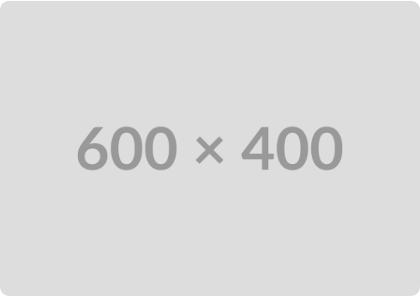
STRUCTURAL ENGINEERING
NEMA VE 1 / VE 2 Support Standards
NEMA Load Class Ratings
Class 12C (100 lbs/ft @ 12ft) or 20C (100 lbs/ft @ 20ft). Factor wind, ice, and 200 lb concentrated worker load.
Splice Joint Location (0.25 L Rule)
Locate splice connectors at 1/4 span distance from support beam. Never place splices at mid-span.
NEMA VE 2 Fitting Support
Support within 2 feet (600 mm) of each horizontal bend, tee, cross, or vertical reducer fitting.
Thermal expansion guide: Install expansion splice plates every 30 m on straight outdoor aluminum runs.

Slide 8


INSTALLABILITY & ERGONOMICS
Substation & Switchgear Room Clearances
300 mm (12 in) Top Headroom
Required overhead clearance above tray side rail for cable pulling and roller guides.
600 mm (24 in) Side Access
Clear pathway between tray edge and building wall or structural columns for personnel access.
Switchgear Dropping Corridor
Align overhead trays directly with panel top-entry plates to avoid sharp s-bends.
Comply with OSHA 1910 headroom and maintain 2.1 m clear walkway below bottom rack.

Slide 9
PULLING STRESS & FITTINGS
Cable Minimum Bending Radius (MBR)
CLASS 3
CLASS 1
CLASS 2
MV / HV Shielded
CLASS 4
Control / Signal
LV Power
12–15 × OD
Optical Fiber
6 × OD
8–12 × OD
20 × OD
Unarmored instrument pairs; select 300 mm fitting radius.
Armored & unarmored LV; select 450 mm fitting radius.
Dynamic pulling limit to prevent internal glass micro-fractures.
Medium voltage tape shield; specify 600–900 mm fitting radius.
Specify tray fitting radius matching the largest cable diameter: $R_{\text{fitting}} \ge \text{MBR}_{\text{max}}$.

Slide 10




ENVIRONMENTAL & THERMAL DESIGN
Cable Tray Cover Philosophy
Peaked / Flanged Covers
Mechanical Protection
Ampacity Derating
Raised Standoff Spacers
Pitched profile sheds rainwater, snow, and chemical process deposits outdoors.
Solid covers mandatory within 1.8 m of platforms, stairs, and crane lift corridors.
Solid unventilated covers trap heat, penalizing cable ampacity by 10% to 15%.
25–50 mm raised cover brackets restore convective airflow while blocking sunlight.
Use: Outdoor racks & pipe bridges
Use: Falling tool & slag zones
Derating: Apply 0.85–0.90 factor
Fix: Avoid thermal choke points
Specify heavy-duty stainless steel cover hold-down clamps rated for local design wind velocities.

Slide 11
CIVIL & SUBSTATION INTERFACE
Underground Cable Trench Standards
Precast Trench & 1:100 Bed Slope
Reinforced concrete with continuous longitudinal slope towards sumps to eliminate standing water.
Wall-Mounted Cable Racking
Unistrut cantilever brackets along walls; bottom cable level raised ≥ 100 mm off trench floor.
Cover Class & Entry Seals
Heavy RCC/chequered covers for roads; fire-rated gas-tight transits at building entry walls.
Segregate MV power on one side wall and control/instrumentation on the opposing trench wall.

Slide 12
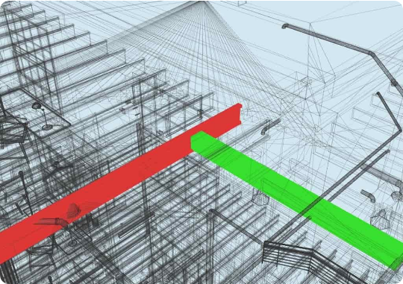
DIGITAL ENGINEERING WORKFLOW
BIM / 3D Clash Coordination
Piping Right-of-Way Rules
Always route cable trays ABOVE steam, hydrocarbon, and slurry pipes to eliminate leak dripping hazards.
HVAC Duct Clearances
Maintain 150 mm minimum separation from chilled air ducts to stop surface thermal condensation.
Zero Soft Clashes
Model cable pull envelopes and maintenance zones directly in Revit/Navisworks models.
Conduct clash tests at tolerance 0 mm for structural steel and 25 mm for insulated piping.

Slide 13
SAFETY & INTEGRITY
Earthing, Bonding & Grounding (NEC 250)
Bonding Jumpers
Main Grid Taps
Low Resistance Limit
Equipment Grounding
Flexible copper braid jumpers across every expansion joint, swivel, and reducer.
Connect tray spine to main earthing ring at 20 m intervals using 70 mm² bare copper.
Measure end-to-end path resistance; must not exceed 0.1 Ω per IEEE standard 525.
Tray cannot substitute for dedicated EGC green wire in branch circuits.
Remove paint, anodized coating, and lacquer completely at all bonding contact lugs.

Slide 14
QUALITY ASSURANCE
Design Review & QA/QC Gate Checklist
Fill Verification: Cross-sectional fill verified ≤ 40% (power) and 50% (control) with 20% spare.
Fitting Radius Validation: Tray bend radii ≥ minimum bending radius of the thickest cable.
Segregation Matrix: HV, LV, and instrumentation lines placed on correct vertical tiers.
Support Calculations: Structural spans validated under NEMA VE 1 with 0.25 L splice rule.
Cover & Trench Compliance: Outdoor peaked covers, ampacity derating, and trench drains checked.
Penetration Details: 2-hour UL-listed firestops and gas barrier seals scheduled on MTO.
Complete sign-off by Lead Electrical Engineer prior to issuing drawings for construction (IFC).

Slide 15
ENGINEERING TRAINING COMPLETE
Thanks & Discussion
Safe raceway design balances electrical segregation, structural loading, thermal derating, and constructability in field execution.
REFERENCE STANDARDS: NEC 392 • NEMA VE 1 / VE 2 • IEEE 525 • IEC 61537 • OSHA 1910

Slide 16

Image Sources
https://www.united-bim.com/wp-content/uploads/2019/04/Clash-detection-for-hotel-project-of-structural-and-MEP.jpg
Source: www.united-bim.com

